Slide 1
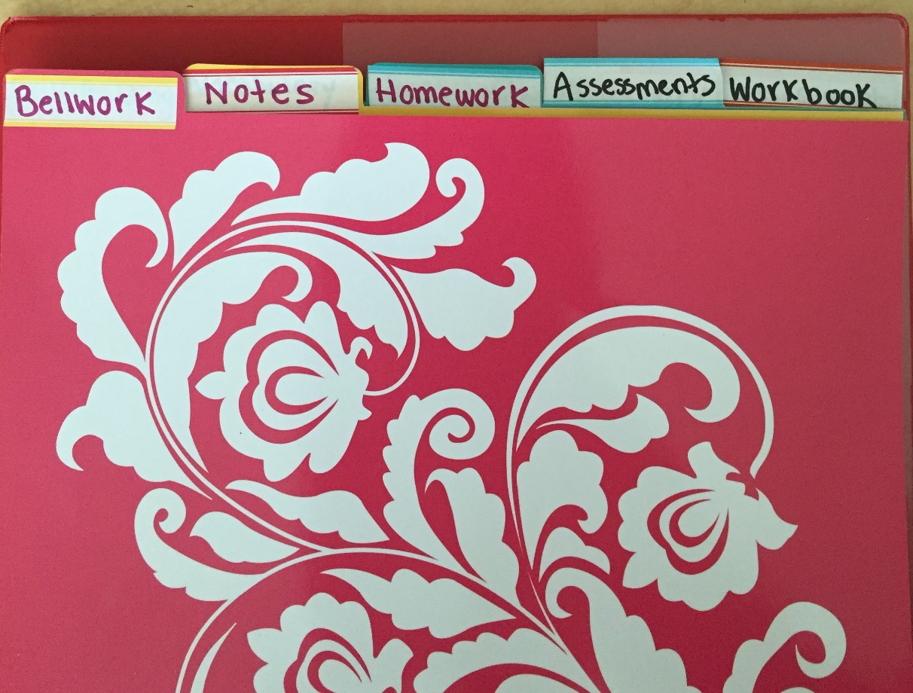
Binder Setup
Open your binder and place the 5 dividers inside.
The 5 dividers need to be named as follows:
  Bellwork
  Notes
  Homework
  Assessments
  Workbook

Slide 2
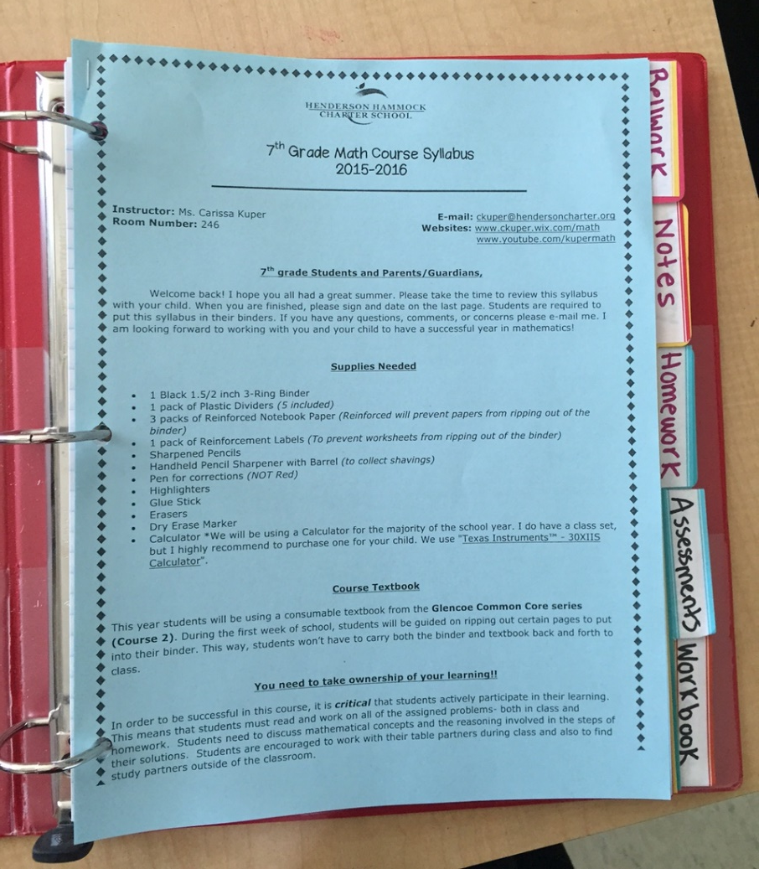
3) Put your Syllabus IN FRONT of the Bellwork Divider.

Slide 3
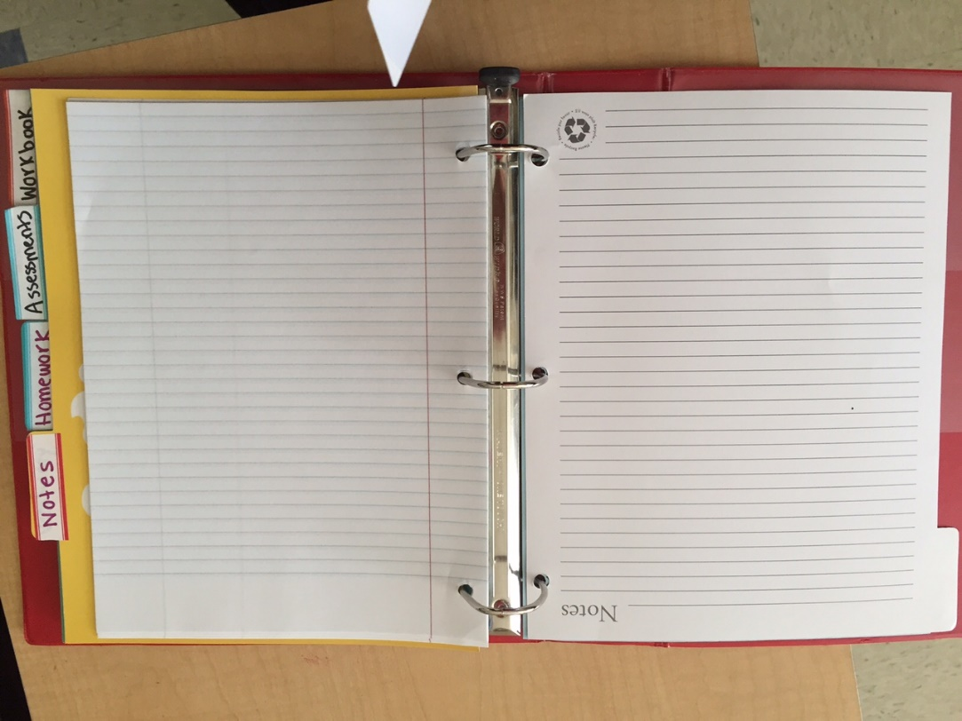
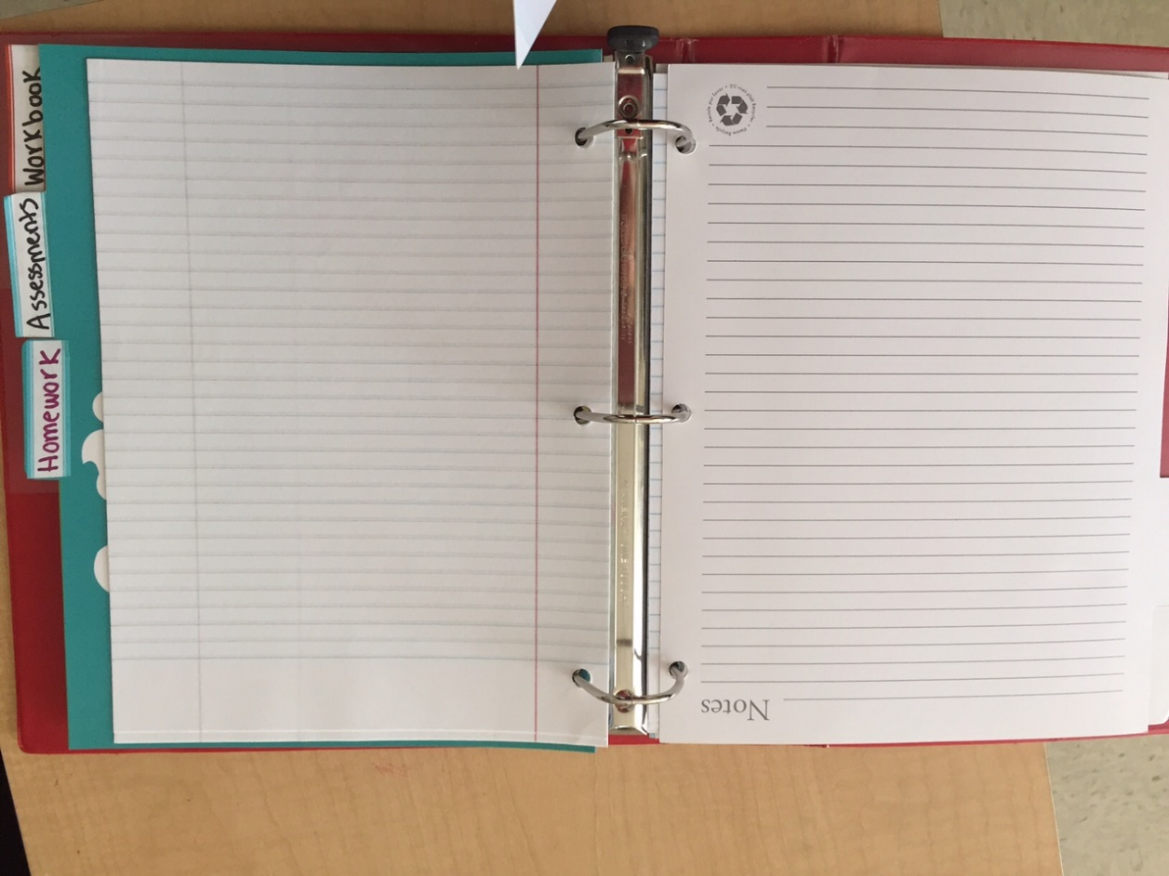
4) Put Notebook paper in the Bellwork and Notes Sections.

Slide 4
CHAPTER 1
CHAPTER 2
CHAPTER 3
CHAPTER 4
8) Rip out the
Following pages
and put into your binder:
iii, v, vii, ix
1, 3, 9, 11, 13, 15
17, 19, 21, 23
25, 27, 29, 31
33, 35, 37, 39
45, 47, 49, 51
55, 57, 59, 61
65, 67, 69, 71
73, 75, 77, 79
81, 83, 85, 87
91, 93
95
103, 107, 109
111, 113, 115, 117
121, 123, 125, 127
129, 131, 133, 135
137, 139
143, 145, 147, 149
151, 153, 155, 157
159,161, 163, 165
167, 169, 171, 173
179, 181
185, 187
191, 193, 195, 197
199, 201
203, 205, 207, 209
215, 217, 219, 221
223, 225, 227
233, 235, 237, 239
243, 245, 247, 249
251, 253, 255
257
261, 263, 265, 267, 269
271, 273, 275, 277
283, 285, 287, 289
291, 293, 295, 297
299, 301, 305,
309
311, 313, 315, 317
319, 321, 323, 325
327, 329, 331, 333
337, 339
Workbook pages to tear out and transfer to Workbook Section in your Binder
OTHER
ALL OF THE GLOSSARY
WM1, WM3
FL3, FL5, FL7, FL9

